Slide 1


CS-482: Introduction to Blockchain and CryptoCurrency
Lecture # 8: Community, Politics and Regulations
Prof. Dr. Sufian Hameed
Department of Computer Science
FAST-NUCES

Slide 2
Consensus in Bitcoin

Slide 3
Consensus about Rules
Agree on:
- what makes a transaction valid
- what makes a block valid
- how P2P nodes should behave
- protocols and formats

Slide 4
Consensus about History
Agree on contents of the blockchain
therefore: which transactions have occurred
therefore: which coins exist and who owns them

Slide 5
Consensus that Coins are Valuable
General agreement that coins have value
Any currency needs this
“Tinkerbell effect”

Slide 6
consensus about rules
consensus that coins are valuable
consensus about history

Slide 7
Bitcoin Core Software

Slide 8
Bitcoin Core software
open source (MIT license)
the most widely used Bitcoin software
those who don’t use it follow its lead on rules
Bitcoin Core is the de facto rule book of Bitcoin

Slide 9
Bitcoin Improvement Proposals (BIPs)
“formal” proposal for changes to Bitcoin
includes technical spec and rationale
published in a numbered series
each BIP has a champion to evangelize / coordinate
also: informational BIPs, process-oriented BIPs

Slide 10






Core developers:
Wladimir van der Laan
Gavin Andresen
Jeff Garzik
Satoshi Nakamoto
Pieter Wuille
Gregory Maxwell

Slide 11
How powerful are the lead developers?
their rule changes will be followed by default
but anyone can fork the software at any time
Lead devs are “leading the parade”.

Slide 12
If users don’t like a rule change:
Centralized currency: Users have the right to exit.
Bitcoin: Users have the right to fork the rules.
Right to fork is more empowering than right to exit.
⇒ community retains more power

Slide 13
If there’s a (hard) fork in the rules:
“A-coin”
Valid under A rules
Invalid under B rules
“Bitcoin”
Valid under B rules
Invalid under A rules
“B-coin”
“the currency forked”

Slide 14
After a hard fork:
(If fork was meant to start an altcoin:
altcoin goes its separate way
branches coexist nicely)
If fork reflected a fight over future of Bitcoin:
branches fight for market share
branches fight to be seen as “the real Bitcoin”
probably one branch wins, one melts away

Slide 15
Stakeholders : Who’s in Charge?

Slide 16
Who has the power in the Bitcoin ecosystem?
Suppose there is a negotiation about rule-setting.
Who controls the outcome?
Depends who would win the fight if they fail to agree.

Slide 17
Claim: Bitcoin Core developers have the power.
They write the rulebook.
Almost everybody uses their code, follows their rules.

Slide 18
Claim: Miners have the power.
Miners write the history.
History will be consistent with miners’ consensus rules.

Slide 19
Claim: Investors have the power.
Investors determine whether Bitcoin has any value.
In case of hard-fork, investors decide which branch wins.

Slide 20
Claim: Merchants and their customers have the power.
They generate the primary demand for Bitcoins.
They drive the long-term price of Bitcoin.
Investors are just guessing where merchants and customers will go.

Slide 21
Claim: Payment services have the power.
They are the ones that really handle transactions.
So they drive primary demand.
Merchants, customers, and investors will follow them.

Slide 22
The Bitcoin Foundation (founded 2012)
pays core developers
talk to governments as “voice of Bitcoin”
some controversy ...

Slide 23
Roots of Bitcoin

Slide 24
Precursors to Bitcoin:
Cypherpunk movement
Early digital cash (Chaum et al.)

Slide 25
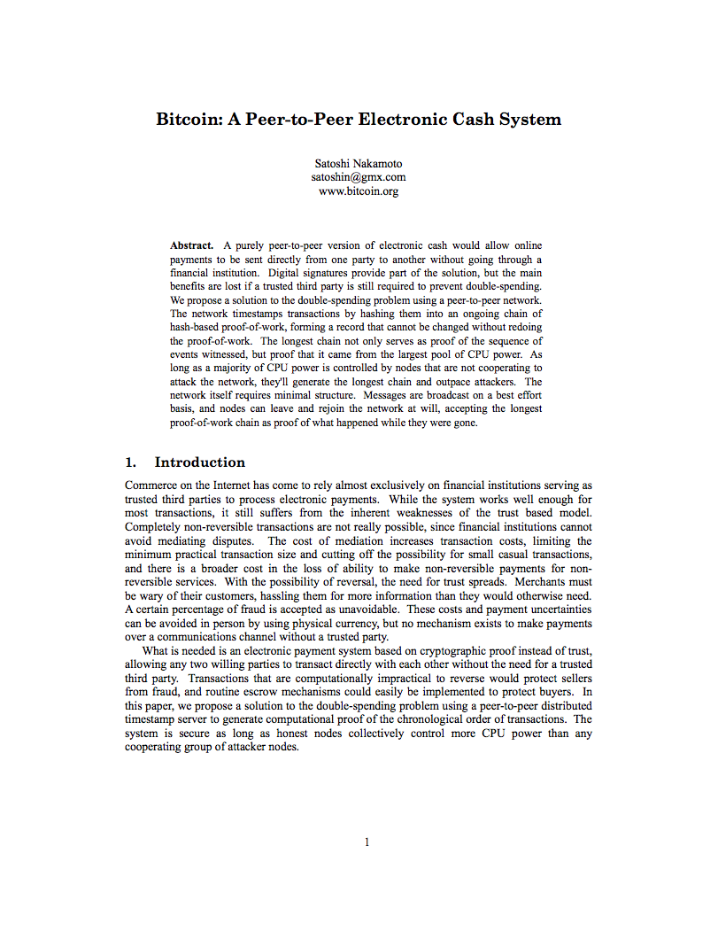
2008

Slide 26
Satoshi Nakamoto
author of white paper and original Bitcoin software
almost certainly a pseudonym
identity associated with certain public keys
writes fairly well in English
has barely been heard from since 2010
owns lots of Bitcoins from early mining
Real identity unknown.

Slide 27
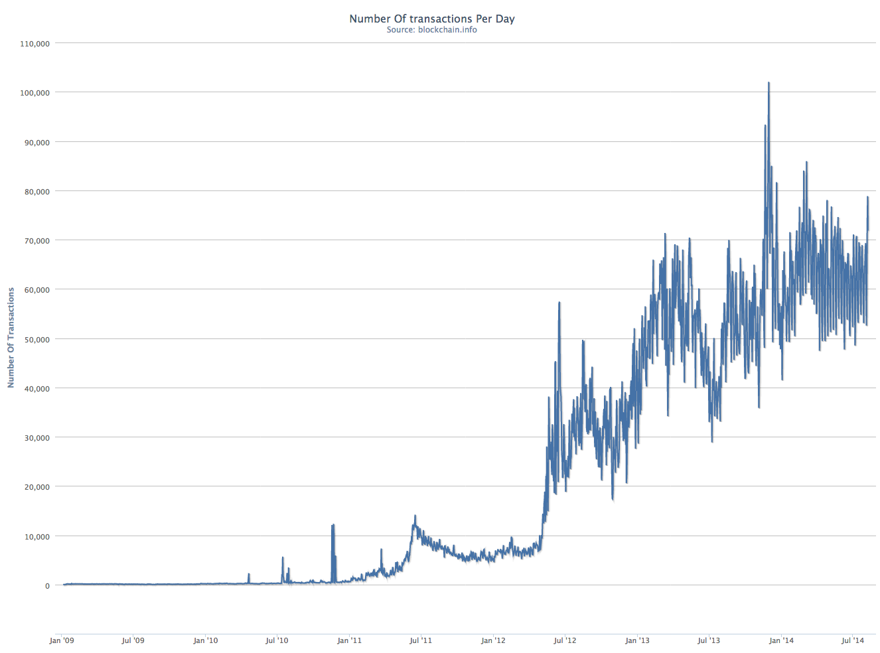
transaction volume / day
2009-2014

Slide 28
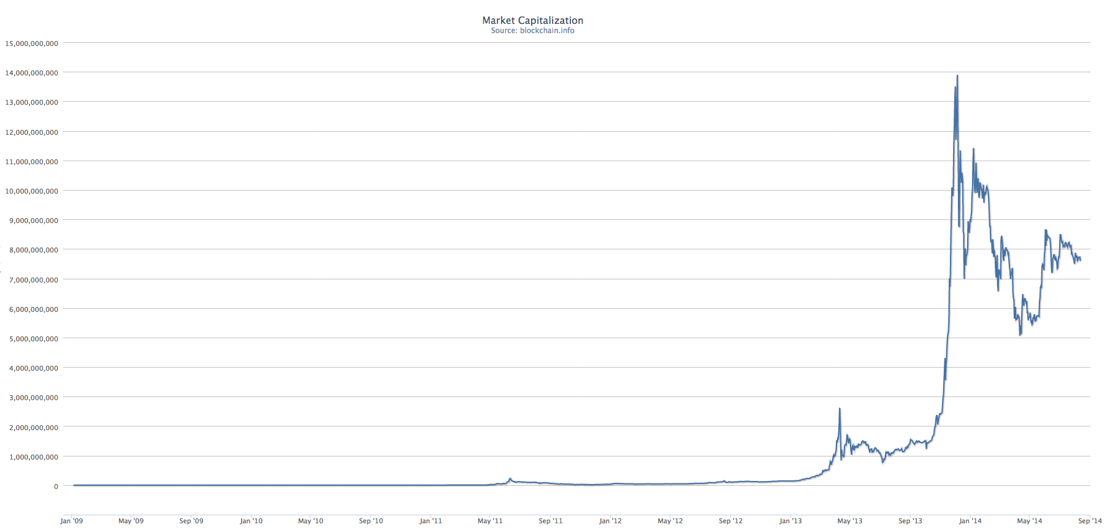
Bitcoin total value
2009-2014

Slide 29
Governments Notice Bitcoin

Slide 30
Untraceable digital cash defeats capital controls:
country can’t stop Bitcoin value from flowing in or out
government countermeasure: disconnect BTC world
from fiat currency financial institutions
example: China

Slide 31
Untraceable digital cash facilitates some crimes:
kidnapping and extortion
tax evasion
sale of illegal items

Slide 32
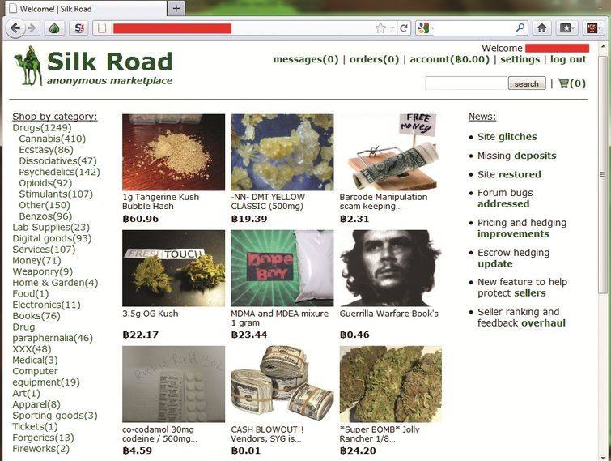

Slide 33
Silk Road
largest online market for illegal drugs
ran as a Tor hidden service
payment in Bitcoins
site held BTC in escrow while goods shipped
eBay-like reputation system
run by “Dread Pirate Roberts”
operated February 2011 to October 2013

Slide 34

arrested October 2013
awaiting trial
government says he tried to cover his tracks, but they connected the dots
government seized 174,000 BTC
auctioned them to the public
Ross Ulbricht
alleged operator of Silk Road

Slide 35
lessons:
hard to keep real and virtual separate
hard to stay anonymous for a long time
Feds can “follow the money”
⇒ money becomes untouchable

Slide 36
Anti Money-Laundering

Slide 37
goal of AML: stop large amounts of money from
(1) crossing borders, or
(2) moving from underground to legitimate economy
without detection

Slide 38
Know Your Customer (KYC):
(1) identify and authenticate clients,
(2) evaluate risk of client,
(3) watch for anomalous behavior.

Slide 39
Mandatory reporting in U.S.:
Must report currency transactions over $10,000.
⇒ file “currency transaction report”
Must watch for clients “structuring” transactions to
avoid reporting.
⇒ file “suspicious activity report”
Requirements differ by country; consult your lawyer.

Slide 40
Note well: government takes this very seriously!
Bitcoin businesses have been shut down.
Businesspeople have been arrested.

Slide 41
Regulation

Slide 42
Argument against regulation is common, well understood.
Argument for regulation not as well understood.
When markets fail and produce bad outcomes,
regulation can address the failure.

Slide 43
Market failure example: Lemons market
Market for widgets, can be low-quality or high-quality
High-quality (HQ)
- costs a bit more to make
- consumers like them much better
Efficient market would deliver mostly HQ
What if consumers can’t tell HQ apart from LQ?
⇒ consumers won’t pay extra for HQ
⇒ sellers won’t sell HQ

Slide 44
Fixing a lemons market
Market-based approaches
seller reputation
warranties
Regulation
required disclosure, with penalties for lying
quality standards, with enforcement
required warranties, with enforcement

Slide 45
Market failure example: Price fixing
Sellers agree to raise prices
related: agreement not to compete
These are illegal in most jurisdictions.
part of “antitrust” or “competition” law

Slide 46
New York’s BitLicense Proposal

Slide 47
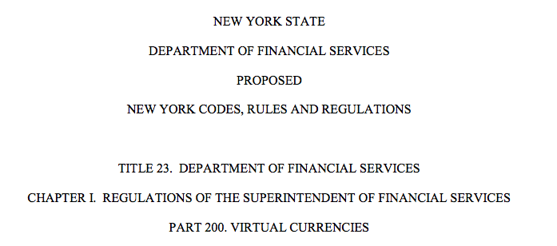
New York “BitLicense” proposal
July 2014
http://www.dfs.ny.gov/about/press2014/pr1407171-vc.pdf

Slide 48
Would need a “BitLicense” from NYDFS to do any of these things:
Virtual Currency Business Activity means the conduct of any one of the following …
involving New York or a New York Resident:
(1) receiving Virtual Currency for transmission or transmitting the same;
(2) securing, storing, holding, or maintaining custody or control of Virtual Currency on behalf of others;
(3) buying and selling Virtual Currency as a customer business;
(4) performing retail conversion services, including the conversion or exchange of Fiat Currency or other value into Virtual Currency, the conversion or exchange of Virtual Currency into Fiat Currency or other value, or the conversion or exchange of one form of Virtual Currency into another form of Virtual Currency; or
(5) controlling, administering, or issuing a Virtual Currency

Slide 49
Applying for a licence
Provide information on
ownership
finances and insurance
business plan
Pay an application fee

Slide 50
Licensees must:
Provide updated information to NYDFS
including periodic financial statements
Maintain a financial reserve
amount set by NYDFS
Follow rules on
custody of consumer assets
anti money laundering
cybersecurity and disaster recovery
recordkeeping
Designate a compliance officer, have written policies
Disclose risks to consumers

Slide 51
Status of BitLicense proposal [August 2014]
Proposed by NYDFS
Public comments solicited by NYDFS
After comments are in, NYDFS will decide what to do
Prediction: some kind of BitLicense will be put in place

